Slide 1
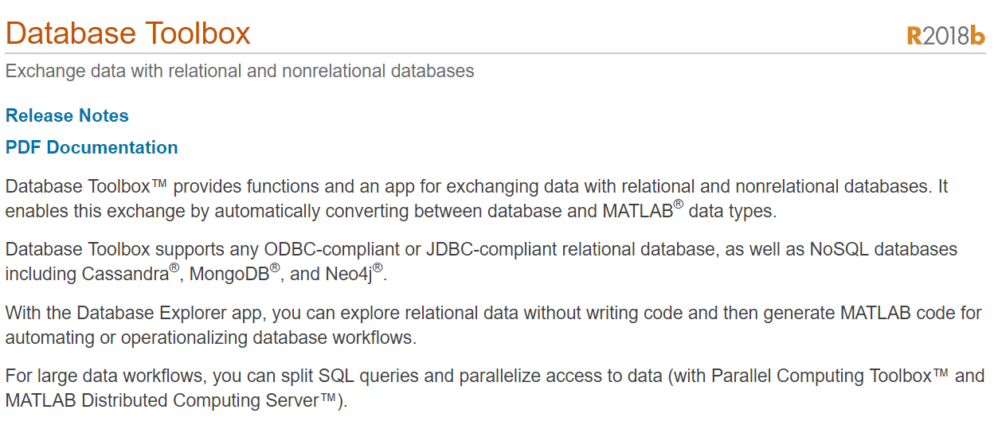
Matlab Database Toolbox
https://www.mathworks.com/help/database/index.html

Slide 2



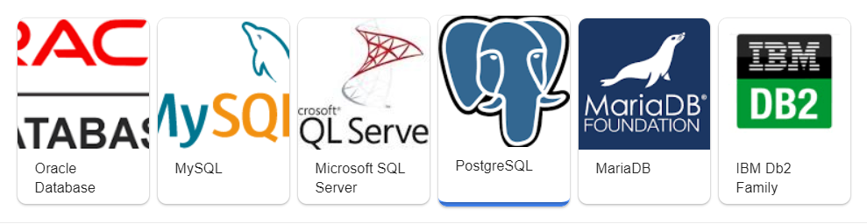

Database Connection in Matlab
Database explorer
Matlab script
Matlab native interface to MySQL
Matlab native interface sqlite() to sqlite
Download drivers
DBbrowser
SQL language

Slide 3
SQLite Database Connection MATLAB database explorer using a JDBC Driver
Resources:
https://www.mathworks.com/help/database/ug/configuring-driver-and-data-source.html
https://www.mathworks.com/help/database/ug/sqlite-jdbc-windows.html#bt5he_9-1
JDBC Driver download: https://repo1.maven.org/maven2/org/xerial/sqlite-jdbc/3.27.2.1/
Use database explorer to connect the sqlite database
In command line execute the following, be sure to change it to your folder containing the jdbc driver
>> javaaddpath 'C:\Program Files\MATLAB\R2018a\jdbc\sqlite-jdbc-3.16.1.jar’
>> javaaddpath 'C:\Users\14152\Downloads\sqlite-jdbc-3.27.2.1-javadoc.jar'
Open up the database explorer from APPS tab. Then Click on Configure Data Source
Name: sqlite
Vendor: other
Driver: org.sqlite.JDBC
URL: jdbc:sqlite:C:\Teaching\BMES 375-2020-summer-final\database\weightdata.sqlite
jdbc:sqlite:C:\BMES 375-2021-Fall\hw4-database\weightdata.sqlite
Then save the connection
Click on new query

Slide 4
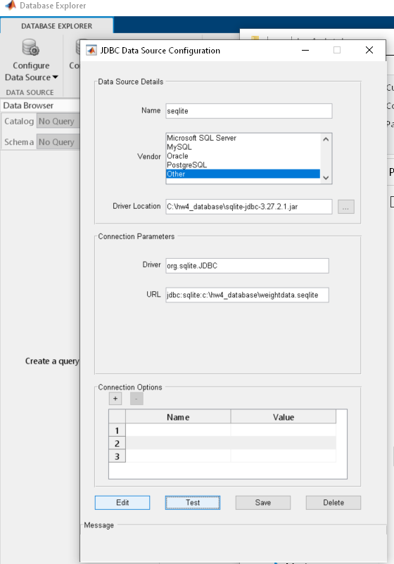

Slide 5
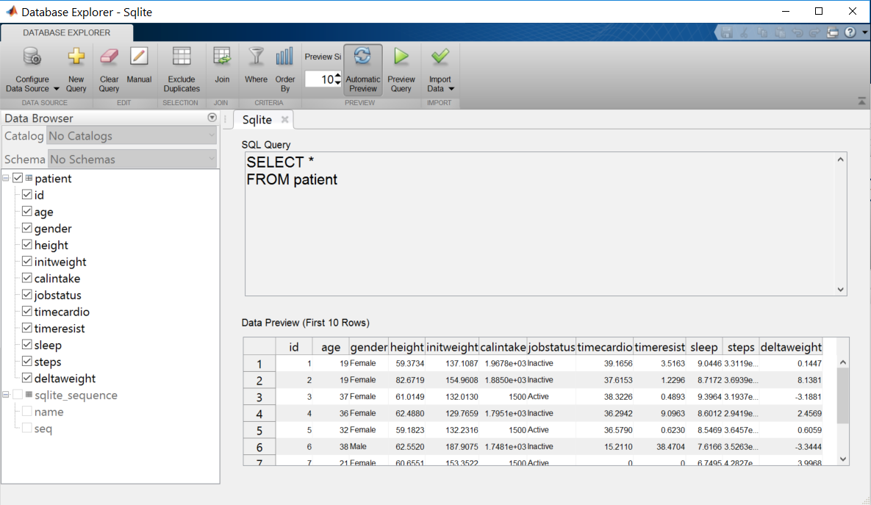
Matlab database explorer is equivalent to DB Browser

Slide 6
Explore the patient's table
The dataset will be used in homework 5
How many columns?
What does each column mean
Perform some SQL search in manual mode, such as the following examples
Click on “Manual SLQ”. Let’s run a few SQL statements
Select age column from patients table
SELECT age FROM patient
Count how many patients where height>60 ordered
SELECT count(*) FROM patient WHERE height>60

Slide 7
Exercise 4: practice SQL in MATLAB database explorer
Write and execute SQL to get all the data for patients that don't exercise (these patients have
timecardio AND timeresist of zero. Show the 10 such patients
Write and execute SQL to count how many patients that don't exercise (these patients have
timecardio AND timeresist of zero.
Write and execute SQL to count how many patients that are male based on gender
Write and execute SQL to count how many patients that are active based on jobstatuse

Slide 8
SQLite Database Connection through
Matlab interface/JDBC Driver in Matlab script

Slide 9
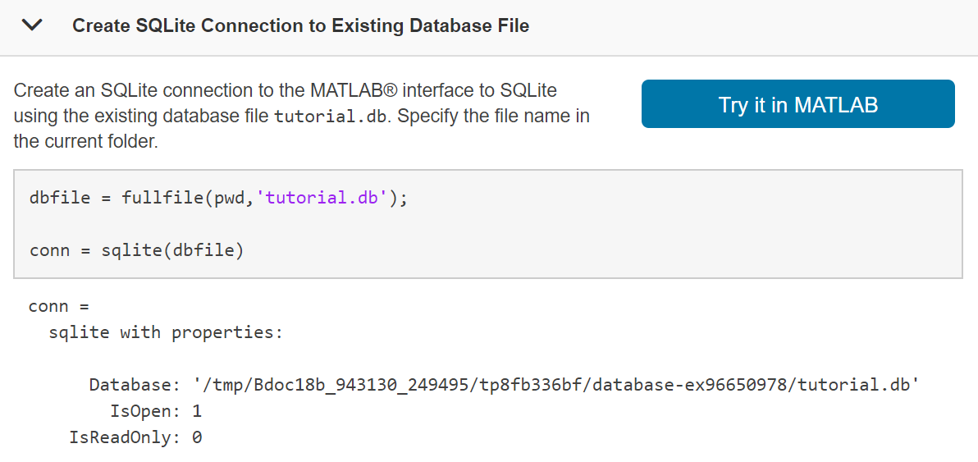
SQLite Connection Using the MATLAB Interface to SQLite
https://www.mathworks.com/help/database/ug/sqlite.html#bu5myik-1

Slide 10
MATLAB_Interface_to_SQLite.mlx
MATLAB_Interface_to_SQLite_WI19-20.mlx
dbfile = fullfile(pwd,'weightdata.sqlite');
conn = sqlite(dbfile)
sqlquery = 'SELECT * FROM patient';
results = fetch(conn,sqlquery)
It returns the data in cell array
insert | Add MATLAB data to SQLite database table
exec | Execute SQL statement using SQLite connection
fetch | Import data into MATLAB workspace using SQLite connection
close | Close SQLite connection

Slide 11
SQLite Database Connection Using a JDBC Driver
MATLAB_SQLite_jdbc_WI19-20.mlx
Use command line:
>> javaaddpath 'C:\Program Files\MATLAB\R2018a\jdbc\sqlite-jdbc-3.16.1.jar'
conn = database('SQLite','username','pwd','org.sqlite.JDBC','URL')
conn = database('sqlite','','','org.sqlite.JDBC','jdbc:sqlite:C:\Teaching\BMES 375\Homework\hw4db_weight_loss\weightdata.sqlite')

Slide 12
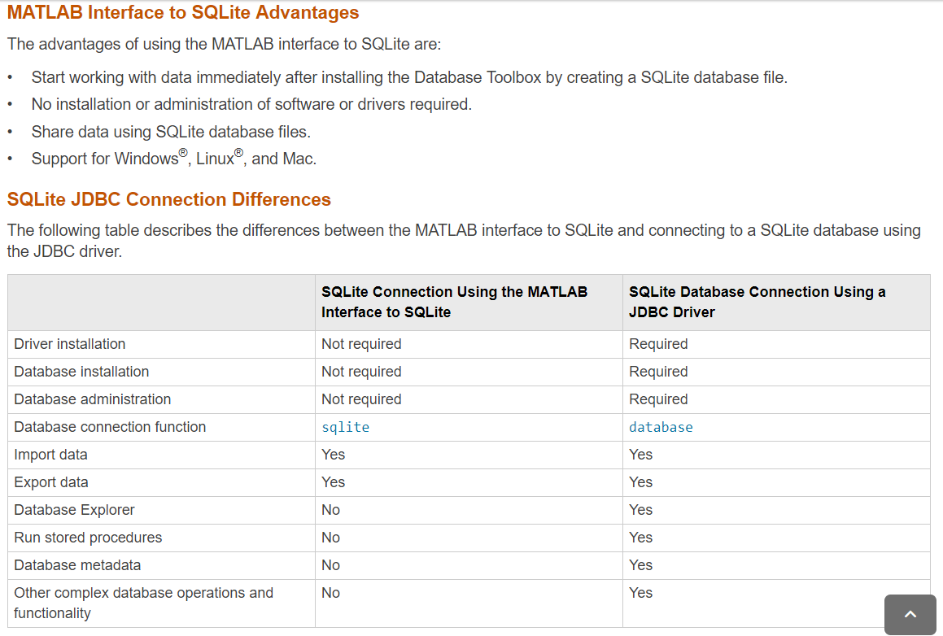
https://www.mathworks.com/help/database/ug/working-with-the-matlab-interface-to-sqlite.html

